Slide 1
How Do I Refresh Others?
怎样使人灵里快活？
1 Corinthians 16: 17-18
哥林多前书16:17-18

Slide 2
神奇的唇膏新品能助你减肥…

Slide 3
1 Corinthians 16: 17-18 哥林多前书16:17-18
17 I was glad when Stephanas, Fortunatus and Achaicus arrived, because they have supplied what was lacking from you. 18 For they refreshed my spirit and yours also. Such men deserve recognition.
17 司提反和福徒拿都，並亞該古到這裡來，我很喜歡；因為你們待我有不及之處，他們補上了。
18 他們叫我和你們心裡都快活。這樣的人，你們務要敬重。
THEY REFRESHED (16:18a)
他們叫我和你們心裡都快活。

Slide 4
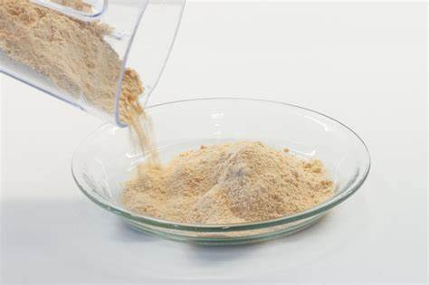
DO YOU REFRESH? 你叫人灵里快活吗？

Slide 5
16:18 For they refreshed my spirit and yours also.
16:18 他們叫我和你們心裡（灵里）都快活。
SUMMARY:
1.) I NEED TO BE REFRESHED.
我要心（灵）里快活
2.) I NEED TO REFRESH OTHERS.
我要让他人心（灵）里快活

Slide 6
Who were these men?是哪些人？
16:17 I was glad when Stephanas, Fortunatus and Achaicus arrived, because they have supplied what was lacking from you.
17 司提反和福徒拿都，並亞該古到這裡來，我很喜歡；因為你們待我有不及之處，他們補上了。

Slide 7
How do You Refresh Others? 怎样让他人灵里快活？
1.) They arrived (16:17a)他们来到
16:17 simply says “I was glad when Stephanas, Fortunatus and Achaicus arrived”
16:17 司提反和福徒拿都，並亞該古到這裡來，我很喜歡；
YOU SHOW UP! 到这里
YOUR PRESENCE 出现

Slide 8
YOUR PRESENCE COMMUNICATES TO OTHERS 你的同在对其他人这样说：
A.) You are important to me.
“I Value you.”
你对我来说很重要，“我看重你”
Do not underestimate the “Power of Presence”
不要低估了 “你的同在”的威力。

Slide 9
YOUR PRESENCE – YOUR LIFE – IS A GIFT GIVEN BY GOD TO YOU TO GIVE TO OTHERS.
你的同在 - 你的生命 – 是神给你的礼物，用来给予他人的
SHELFISHNESS IS THE DUCK TAPE THAT NEVER ALLOWS THE SELF – THE GIFT OF YOUR PRESENCE – TO BE UNWRAPPED FOR OTHERS.
自私就是那缠在礼物外面的胶布 —你的同在的礼物，不愿为他人打开

Slide 10
FACE CHECK
ATTITUDE CHECK
表情 态度

Slide 11
YOUR PRESENCE COMMUNICATES TO OTHERS你的同在对其他人这样说：
B.) You are not alone.
“We are in this together.”
你不是一个人，我们一起来面对

Slide 12
YOUR PRESENCE COMMUNICATES TO OTHERS你的同在对其他人这样说：
C.) I love you.
“I care for you.”
我爱你，我关心你

Slide 13
上帝想要你灵里快活 上帝想让你帮助他人灵里快活 你怎么做到呢？ 来到——出现—— 你的同在
SUMMARY:
GOD WANTS YOU TO BE REFRESHED
GOD WANTS YOU TO REFRESH OTHERS.
HOW DO YOU DO THAT?
ARRIVE – SHOW UP – GIVE YOUR PRESENCE.

Slide 14
How did They Refresh Others? How do You Refresh Others? 他们是怎样使人灵里快活的？我们应该怎样使他人灵里快活？
2.) They supplied (16:17b)
“because they have supplied what was lacking from you.” 16:17b
因為你們待我有不及之處，他們補上了。
YOU SUPPLY.
给予

Slide 15
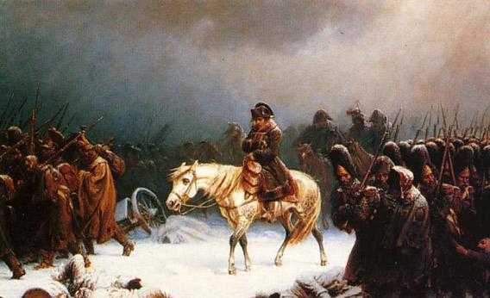

Slide 16
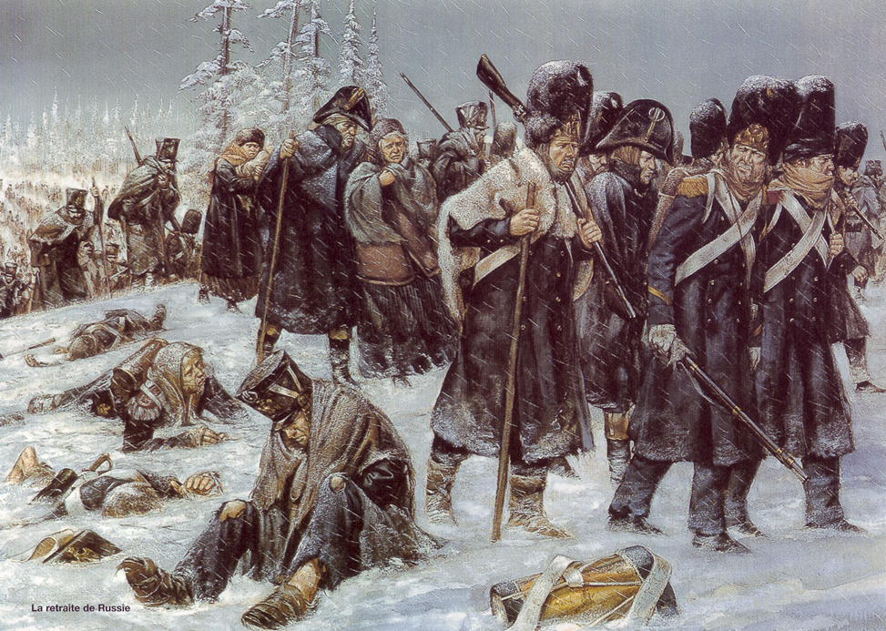

Slide 17
TRUTH ABOUT ME
“I AM NOT FULL / I AM IN NEED”
我不满足/我有需要
I NEED GOD.
I NEED OTHERS
我需要神
我需要他人

Slide 18
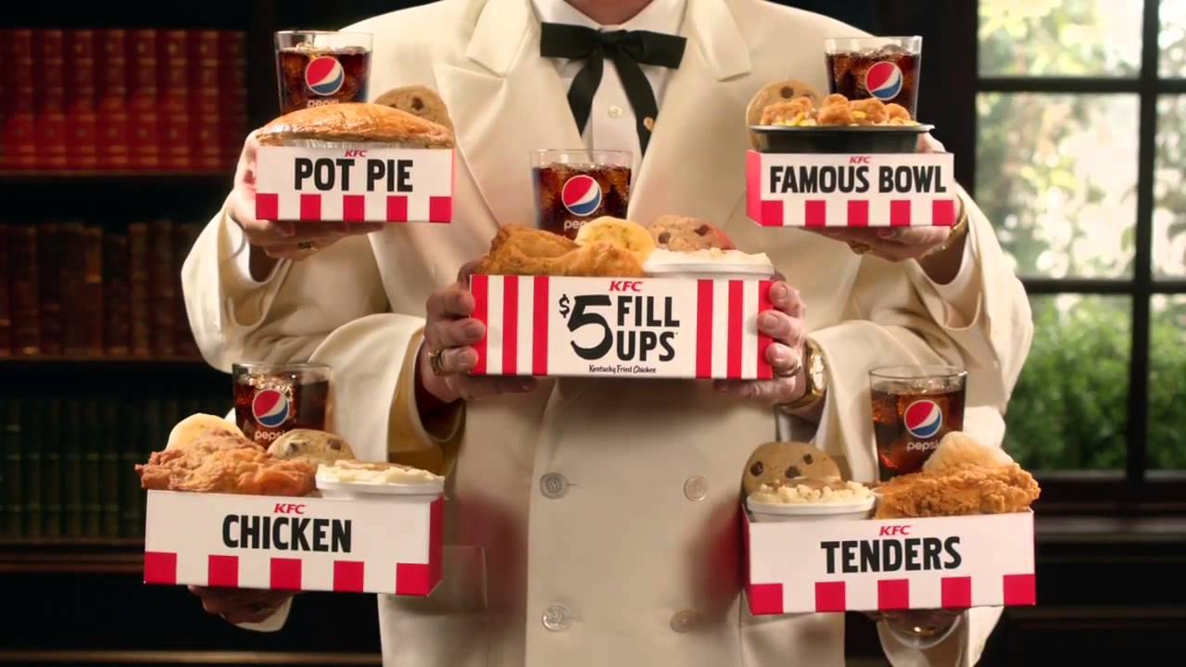
TRUTH ABOUT PEOPLE AND SUPPLY: 有关人和供给的事实：
1.) Not everyone will fill you up. 并不是人人都能满足你
2.) Different people will fill you up in different ways.
不同的人满足你不同的需要

Slide 19
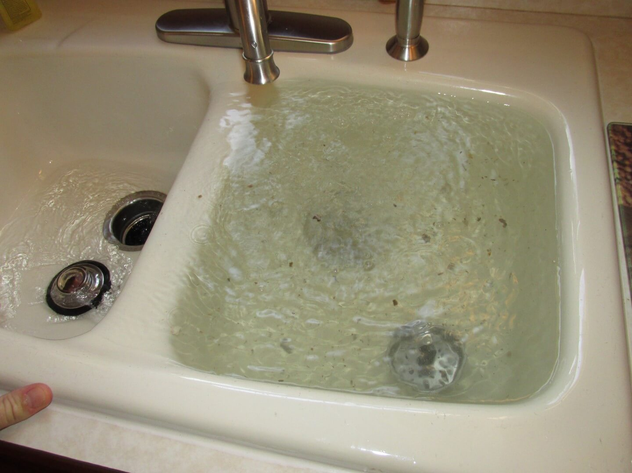
TRUTH ABOUT PEOPLE AND SUPPLY:有关人和供给的事实：
3.) Different types of people
不同类型的人
a.) Some people fill you up.
有的人满足你的需要
b.) Some people will not fill you up (neutral).
有的人不能满足你的需要
c.) Some people drain you.
有的人带来负面影响
d.) Some people will do all three.
有的人三者具备：既可以满足你的需要，或不可以满足你的需要，还会带来负面影响。

Slide 20
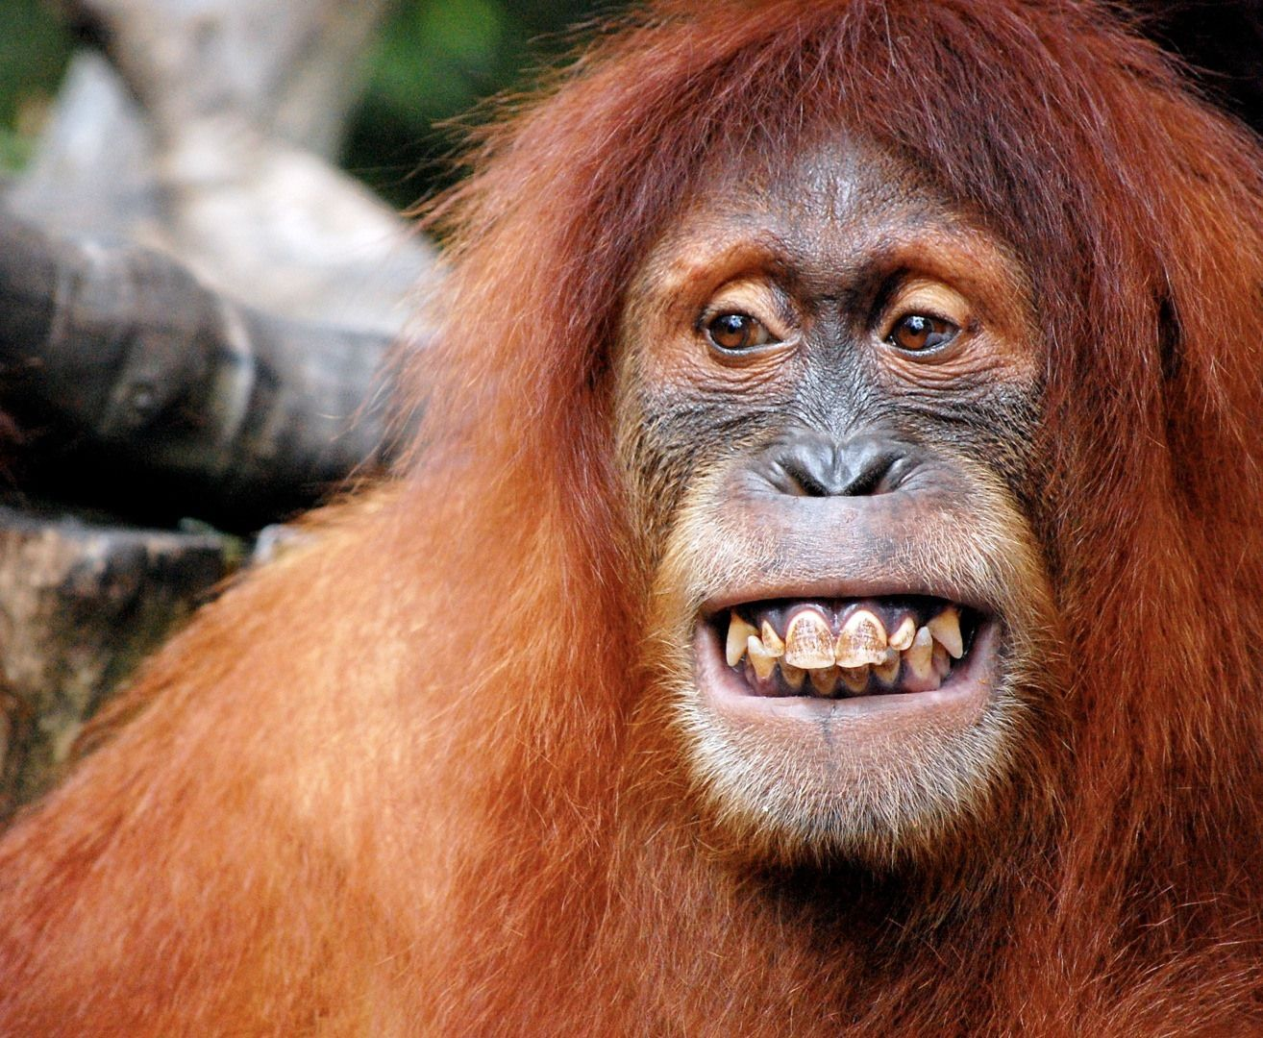
WAYS TO SUPPLY 供应的方法
SMILE 微笑
ENCOURAGE OTHERS 鼓励
PRAY FOR OTHERS 祷告
LISTEN TO OTHERS 聆听
POINT OTHERS TO JESUS
为他人指出到耶稣那里的道路

Slide 21
SUMMARY 总结
I NEED TO BE REFRESHED.
我需要灵里快活
I NEED TO REFRESH OTHERS.
我需要帮助他人灵里快活
THOSE THAT REFRESH OTHERS DESERVE RECOGNITION. 那些帮助他人灵里快活的人应该被大家知道
HOW DO WE REFRESH OTHERS?
怎样帮助他人灵里快活？
ARRIVE 出现/到来
SUPPLY 供应

Slide 22
How did They Refresh Others? How do You Refresh Others? 他们是怎样使人灵里快活的？我们应该怎样使他人灵里快活？
16: 15 You know that the household of Stephanas were the first converts in Achaia, and they have devoted themselves to the service of the Lord’s people. I urge you, brothers and sisters, 16 to submit to such people and to everyone who joins in the work and labors at it.
3A.) They devoted themselves to service of the Lord’s people
(16:15b) & 他们以服侍圣徒为念
3B.) They joined in the work & labor (16:16) 他们同工同劳
“Joined in the work” is one word.
同工同劳 是一个字
16:15 弟兄們，你們曉得司提反一家，是亞該亞初結的果子，並且他們專以服事聖徒為念。我勸你們順服這樣的人，並一切同工同勞的人。

Slide 23
How do You Refresh Others? 怎样让他人灵里快活？
YOU WORK TOGETHER.
One word – TEAMWORK.
同工
一心一念 --- 同一梯队

Slide 25
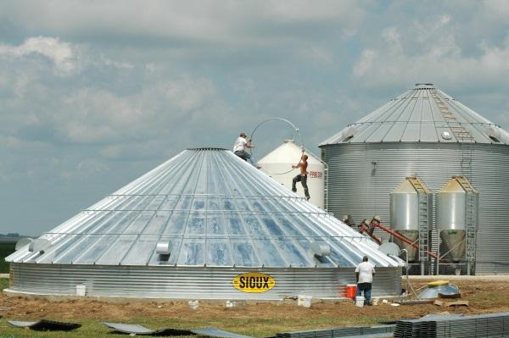

Slide 26
OVERALL SUMMARY: 总结
3.) WORKING TOGETHER - CO-LABORING TOGETHER / SERVING / MINISTERING SIDE BY SIDE – IS REFRESHING. 同工 一同做工/服侍/肩并肩传福音-让人灵里快活
2.) SUPPLYING – FILLING OTHERS UP – IS REFRESHING.给予-满足他人的需要-让人灵里快活
1.) ARRIVING - JUST SHOWING UP/ BEING THERE / YOUR PRESENCE – IS REFRESHING.到来 –出现 / 来到/你的同在 –让人灵里快活
PAUL DECLARES “THIS IS THE MAN OR WOMAN TO BE RECOGNIZED, KNOWN, HONORED, APPRECIATED, EMULATED.
保罗说 ”这样的人应该被人认知，知晓，被尊敬，被感激，被人效仿。
LET US SEEK TO BE THIS TYPE OF MAN OR WOMAN.
愿我们成为这样的人。

